Slide 1
Tetrix Hardware Tips and Techniques

Slide 2
Tetrix Kit Components
Tetrix Hardware
Lego Mindstorms NXT Education Kit
Software (RobotC, NXT-G and LabView)

Slide 3
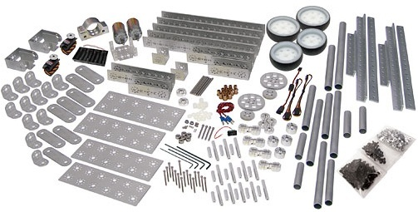
Tetrix Hardware
The Robot’s maximum dimensions at start of challenge:
      18” W x 18” L x 18” H
Tetrix kit (at registration): $900
        $450 for returning teams
Developed by Pitsco and LEGO
Over 500 parts per kit
Subset of the parts
pictured here

Slide 4
Notes:
4

Slide 5
Tips and Techniques
Advantages of the Tetrix Hardware
Tools and such
Arms and grabbing
Connecting Lego pieces to Tetrix
Extras you might need

Slide 6
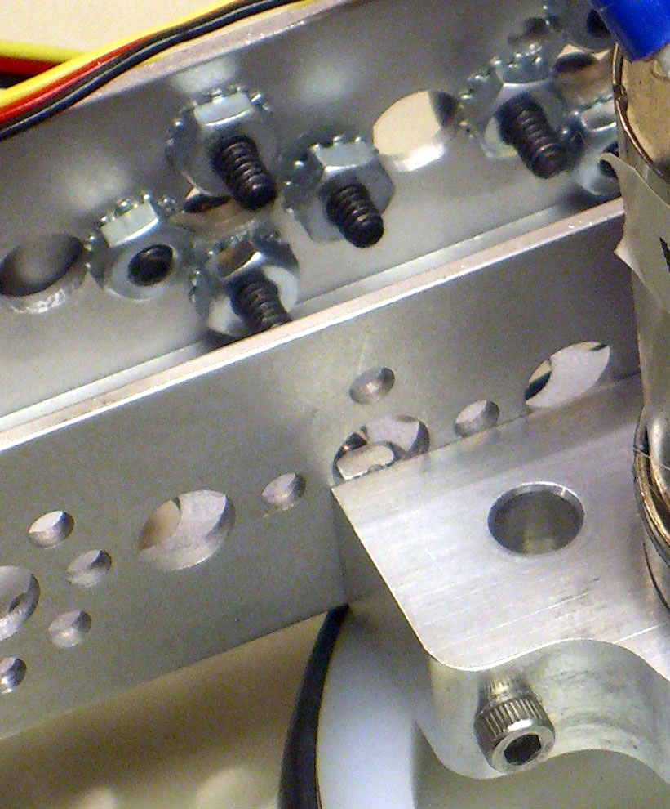
Advantages of the Hardware compared to Vex
Tetrix system makes strong, rugged and robust robots
Screws stay tight!
Grip screwheads with pliers

Slide 7
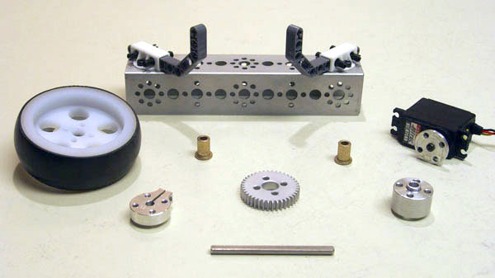
Advantages of the Hardware compared to Vex
Versatile hole patterns

Slide 8
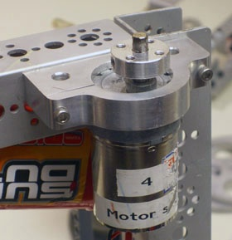
Motors
DC Motors have lots of torque
Two encoders supplied for speed / position control
FTC motor controllers use encoder
Versatile mounting hardware

Slide 9
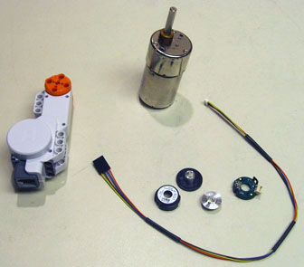
Motors
When do you use Lego motors?
Lego motors don’t have all that much torque, but useful for light loads
They have position feedback

Slide 10
Motors and Gears
While the Lego motors don’t have a lot of torque, there are lots of gears for them.
There aren’t all that many aluminum gears and they are expensive - $20 - $30 each.

Slide 11
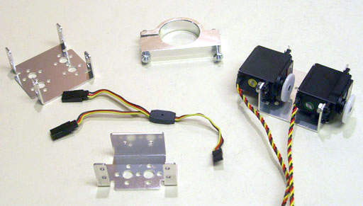
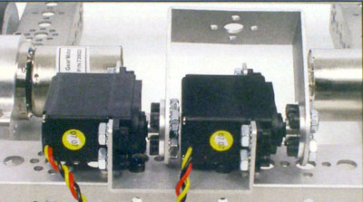
Servos

Slide 12
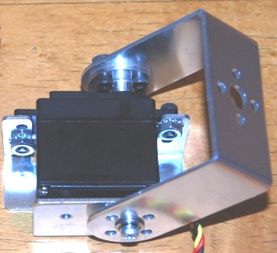
Robust Servo Mounting
brackets for mounting

Slide 13
Servos
Ways to use servos
  Single or double brackets for mounting
  Horn connected to gears, wheels, structural pieces
  Connect to end of pipe
  Be careful of order of assembly – think first, build second
  Warning – Picture in Tetrix Creator’s Guide shows washer on wrong side

Slide 14
Servos
Drive a robot arm with one or two servos, or use a servo on each side of a connected arm
  Requires use of Y connector
  Check form; there was a report of unreliable operation in this mode
You must make sure center position of each servo is aligned when using two servos for a single drive
Other Servo ideas…
Specs: stall torque 61 oz. – in.

Slide 15
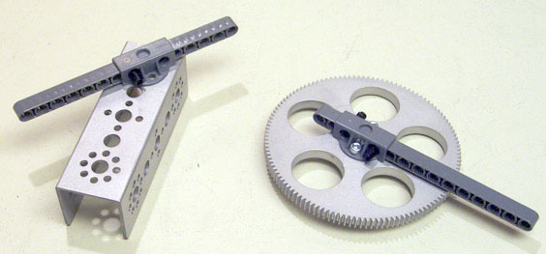
Connecting Lego to Tetrix
A connecting piece is provided to connect between Tetrix and Lego parts - use Lego beams with holes.
Direct connection to Aluminum through Lego holes works.

Slide 16
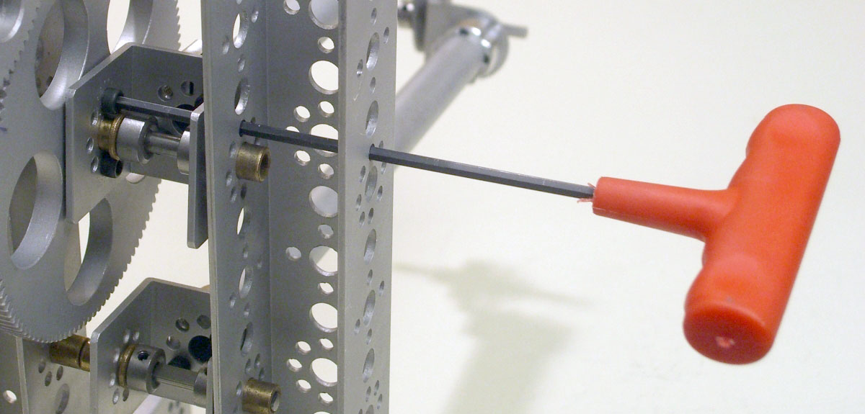
Tools, construction, and tips
Long Allen wrenches are useful for reaching through holes

Slide 17
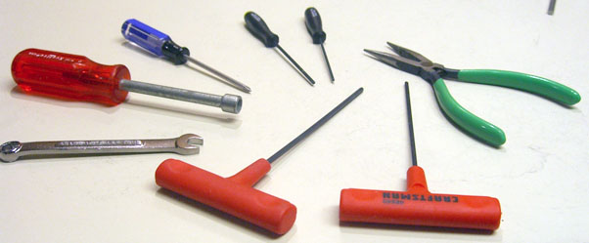
Tools, construction, and tips
It is always good to have more tools…
Ball-end Allen wrenches, electric screwdriver

Slide 18
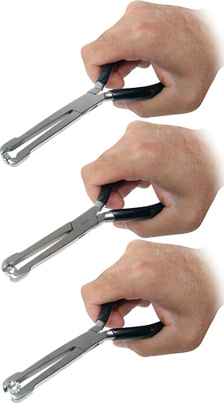
Tools, construction, and tips
The Pitsco store sells “multi-nut pliers”

Slide 19
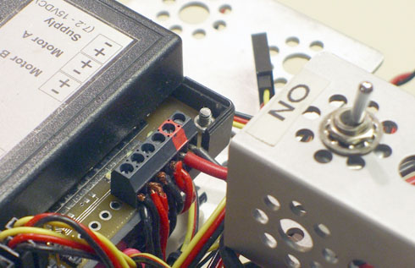
Battery management and electrical issues
Shorts are catastrophic

Slide 20
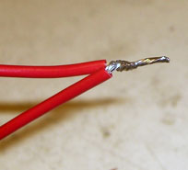
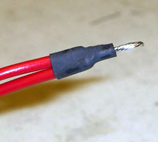
Battery management and electrical issues
Stranded wire can cause shorts due to single strands escaping
In the competition it is not allowed to solder wires or use heat-shrink tubing!

Slide 21
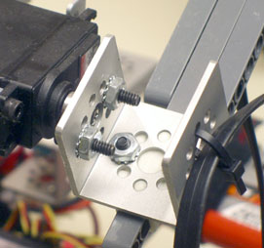
Battery management and electrical issues
Cable routing is important – cables are rather inflexible.
It’s a good idea to attach the cable at the pivot point
An extra battery is essential

Slide 22
Battery management and electrical issues
The controllers can be wired up in a daisy chain, in about any order.
In competition: Only three controllers are allowed; the two with the kit and one additional,
Additional controller can be servo or motor.
Servo or
Motor
Controller
Motor
Controller
NXT
Servo
Controller

Slide 23
Battery management and electrical issues
Wiring up the controllers is where caution is needed. There’s a real potential for shorts.
With the servo controller, must ensure servos are connected in correct polarity.
Four motors can be used with one motor controller by connecting motors in parallel.

Slide 24
Battery management and electrical issues
When using the encoders with the D.C. motors, must check the PID box in setup.
Do Not have box checked if no encoders used.
The encoders are very delicate and expensive…

Slide 25
Battery management and electrical issues
In the competition: Prototype board is the only place soldering is allowed
  (this remark is about the competition, this restriction in theory does not apply to this class).
You can use any electrical or electronic component on this board.
But – you can’t use any more power than is supplied by the I2C connector… (again, this is only for competition)
You need to know how to connect components to a micro-computer chip.
Pull-up resistors are usually needed – to 3.3V
Caution – it’s easy to blow out this board!
  We will not use it if not absolutely necessary in this project.

Slide 26
Pitfalls and Problems
Sonar sensor is hard to use – it seems to be sometimes unpredictable.
  It seems like you cannot turn off it’s pinging, and it may be interfering with itself, or getting bogus reflections.
  If you could figure out how to write a driver for it, you might have better luck.
  There are drivers on WWW
There is an Electro-Optical sensor that you can buy.

Slide 27
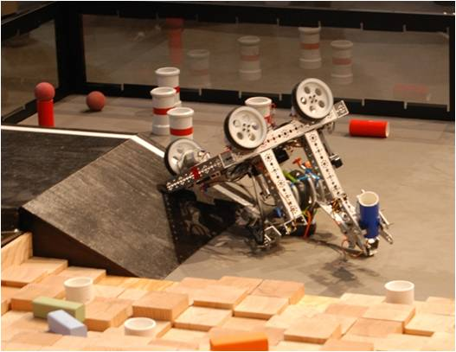
Pitfalls and Problems
Low center of gravity, long wheel base is good
However, you might want to plan for a tip-over - or make the robot unable to tip over
How do you recover from a tip-over?

Slide 28
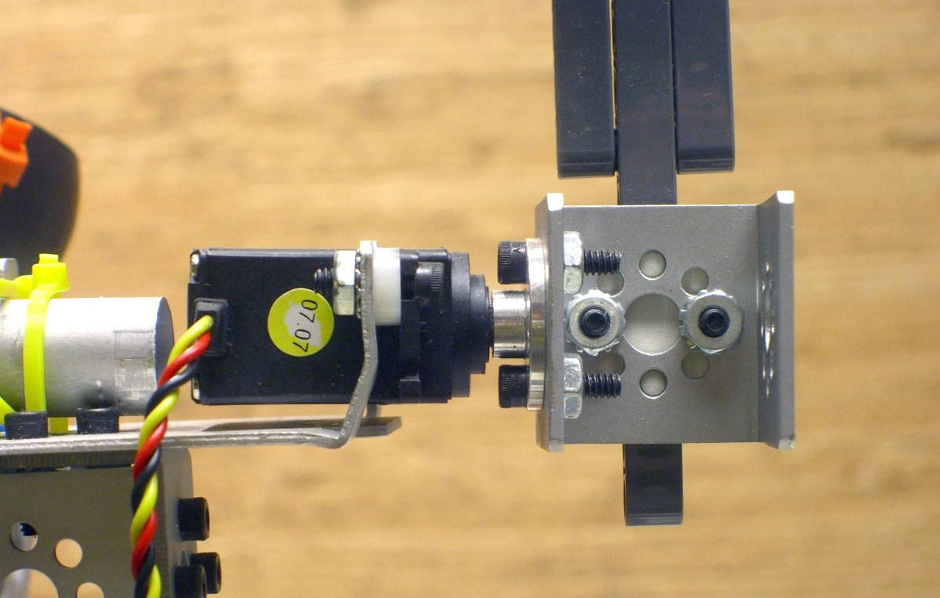
Pitfalls and Problems
Unsupported servos can cause problems

Slide 29
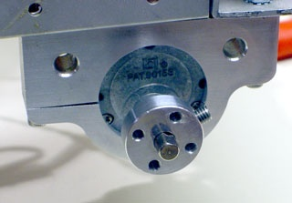
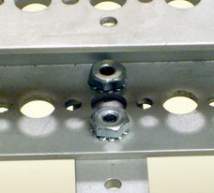
Pitfalls and Problems
Use proper attachment techniques!
In general, the guide recommends using ½” screws
Other sizes used where small clearance needed.

Slide 30
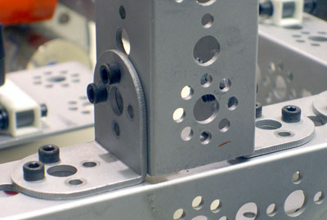
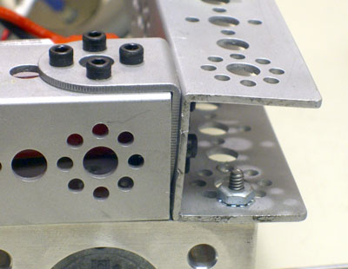
Pitfalls and Problems
Too few screws might be judged against the team
Avoid crooked constructions
Both of these look unprofessional

Slide 31
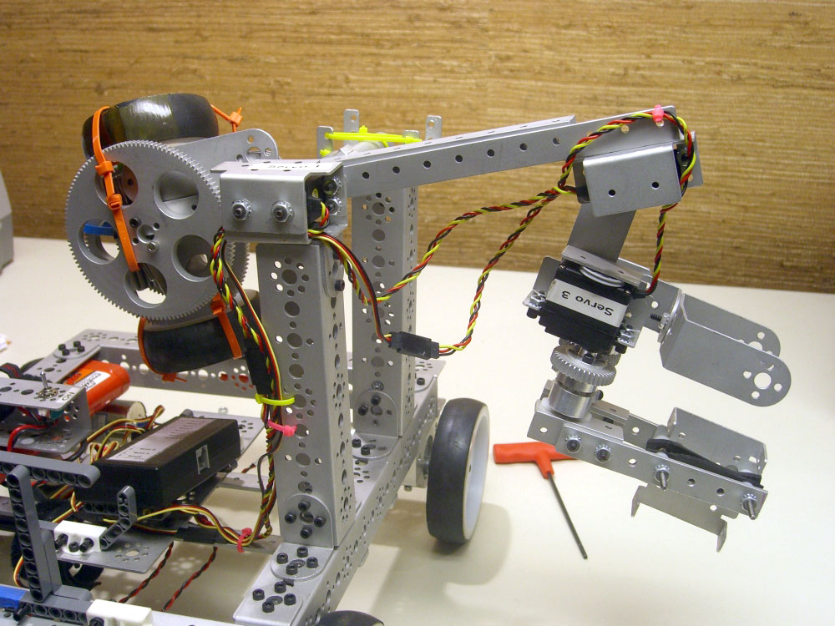
Arms and Grabbing
Counterweights are hard
Parallelogram arms are attractive
Rubber bands, Velcro, cable ties and rope are allowed

Slide 32
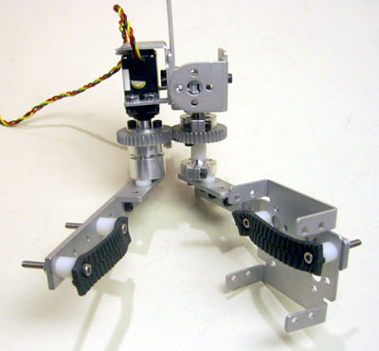
Arms and Grabbing
12” X 15” pad of gripper material is allowed
One piece of polycarbonate and one of aluminum – 12” X 24”
Be creative…

Slide 33
Extras
We needed more screws than provided – but the new kit has more
Note that the 5/16 inch 6-32 screws are very hard to find locally
Pitsco provides 250 screws and only 100 nuts! You’ll definitely need more of these
Better and more tools…

Slide 34
Resources
Check the FIRST Tech Challenge Forum site regularly.
http://forums.usfirst.org/forumdisplay.php?f=26
Tetrix Creator’s Guide – lots of good tips

Slide 35
Differences of Tetrix and Vex
Lego sensors and Hi-Technic sensors are allowed
More motors, servos, sensors, motors with feedback, etc.
Vex parts, Tetrix parts and Lego parts are allowed
As we are not in competition, we can use Vex or any other components.

Slide 37
Instructor Contacts
Coordinator Ed C. Epp edward.epp@intel.com
Robot C for Tetrix Dale Jordan Dale_A_Jordan@msn.com
Advanced RobotC Jeff McBride jeffmc@davincid.com
Tetrix Hardware John DeLacy johncdelacy@comcast.net
NXT-G for Tetrix David Perry DPerry@omsi.edu
ftc-questions@ortop.org

Slide 38
Today’s Goals
Basic construction.
Useful tools and techniques.
Pitfalls.
Get some practice building hardware.

Slide 39
Resources
FIRST FTC Website
  http://www.usfirst.org/community/FTC/
Oregon Robotics and Outreach Program
  http://www.ortop.org
FTC Training at CMU
  http://www.education.rec.ri.cmu.edu/content/events/ftc/
  (The hardware portions of this site has been removed!)

Slide 40
Oregon Robotics Tournament and Outreach Program
Tetrix Hardware Tips and Techniques
November 8, 2008

